Slide 1
You-Tubeing
Talk 7
Copyright Law & Social Media
Allard School of Law, UBC
Spring 2024
Jon Festinger K.C.
Rowan MerEdith
Allard Law of Law, UBC
https://socialmedialaw.allard.ubc.ca

Slide 2
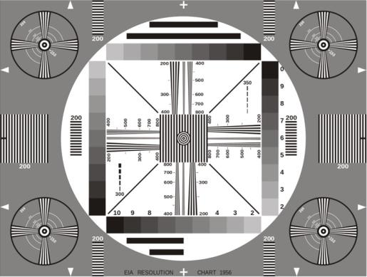
Permission to Record?

Slide 3
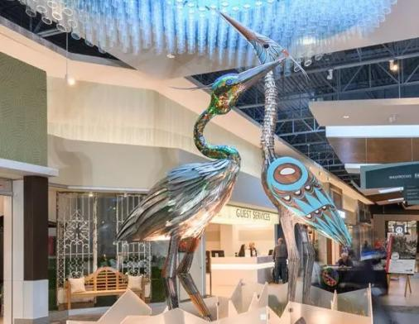
We would like to acknowledge that we are situated on the
traditional, ancestral, unceded territory of the Musqueam people.

Slide 6
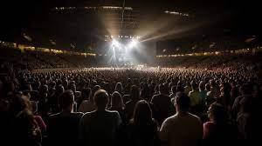
Rowan Meredith World Tour News

Slide 7
Today’s Group Presentation

Slide 8
Brandon Cormier, Josh Lerner,
Rares Minecan, Sian Smart,
Joseph Somers

Slide 9
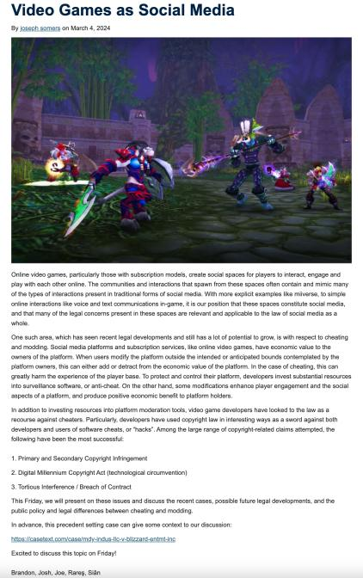

Slide 10
QUESTIONS
THOUGHTS
DISCUSSION

Slide 11
Logistics

Slide 12
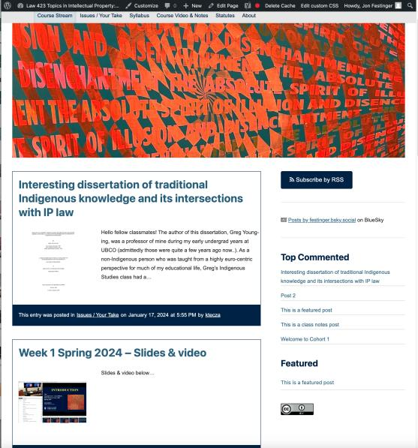
https://socialmedialaw.allard.ubc.ca/

Slide 13
https://socialmedialaw.ubc.ca

Slide 14
For full privileges on the website
1. Please create an account at http://cms.ubc.ca/ using your CWL.
2. Once you create an account and sign in at http://cms.ubc.ca/ you can click your name in the top right. Half-way down the following page will be your WordPress email address.
3. Send me your WordPress email address at jfestinger@telus.net or at jon.Festinger@ubc.ca
4. Then, I will invite you to participate with authoring privileges via your WordPress email address.

Slide 15
Why post?
Engaging and engaging others is the key.
Because you don’t love speaking up in class.
Because you just saw something, and you’ll never remember it unless you post it now.
Please sign your name to your post

Slide 16
Sign your posts?

Slide 17
No “hidden” data collected.

Slide 18
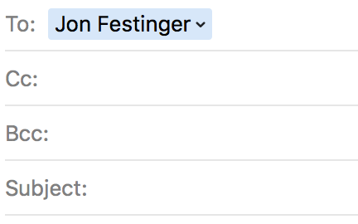
Anything & everything can be
done via email if you prefer

Slide 19
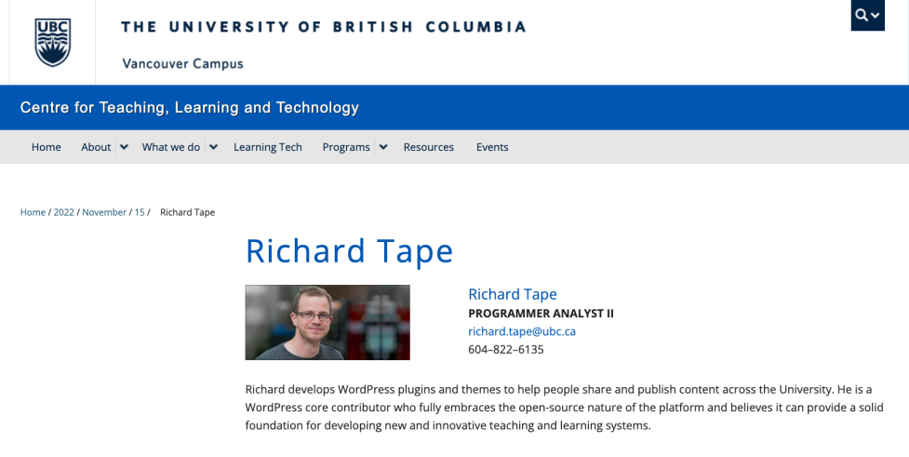
Website issues…

Slide 20
Website Tutorial: How to post

Slide 21
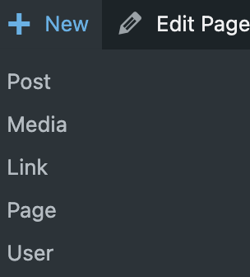

Slide 22
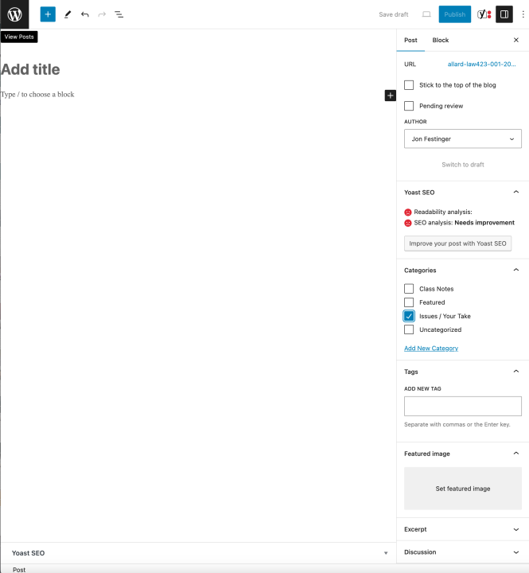

Slide 23
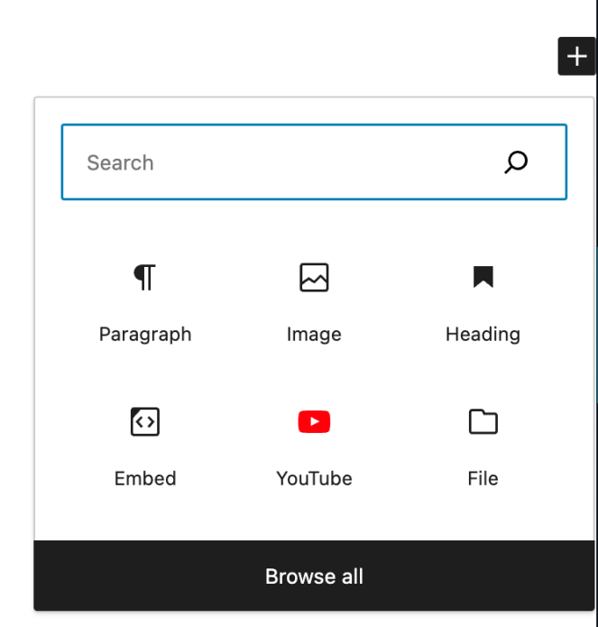

Slide 24
Alternatively…

Slide 26
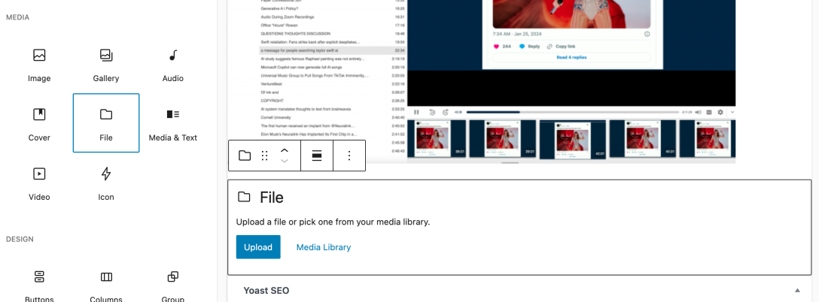

Slide 27
Note…

Slide 28
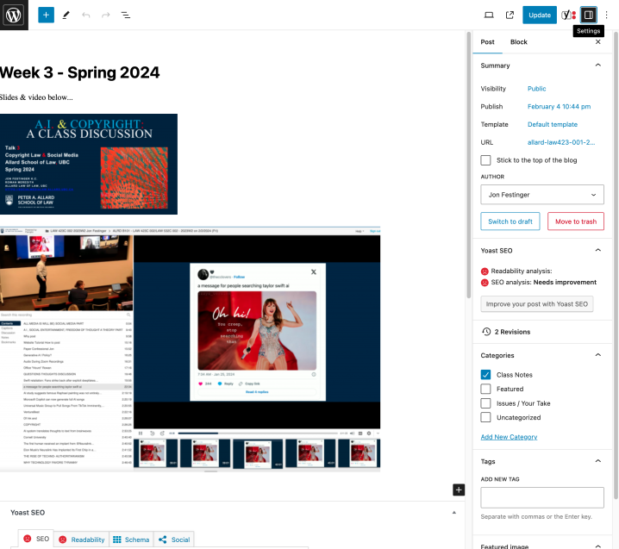

Slide 29
“Living” Syllabus 2nd Edition

Slide 30
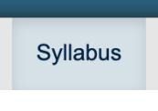

Slide 31
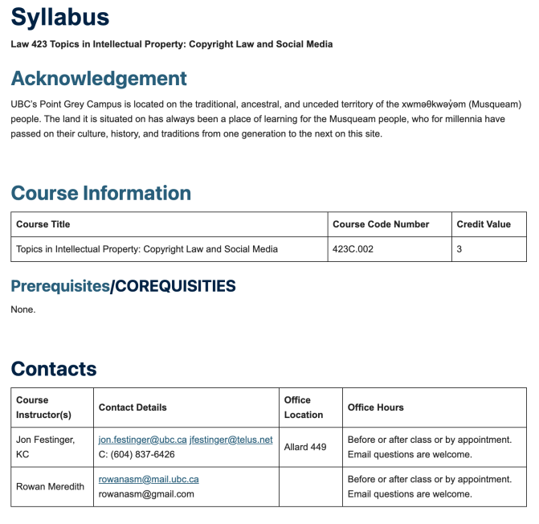

Slide 32
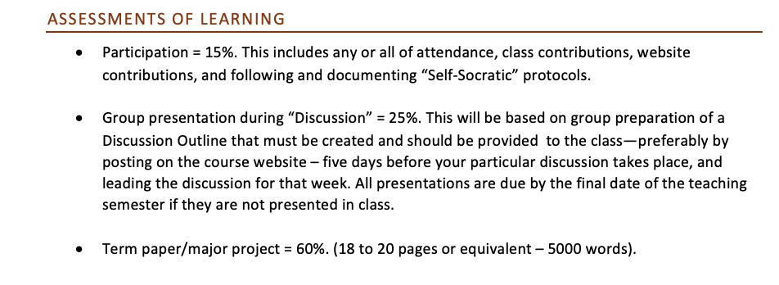
* means one video, podcast, or reading for your
classmates to read watch or listen to…

Slide 33
LLM Students:
One mandatory post
of approx.1000 words?

Slide 34
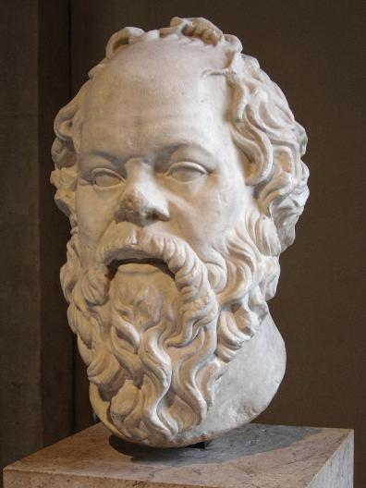
Embedded Self Socratic A.I.: When?

Slide 35
Notes on Grades
Scale-down tendency (ok, after 30 years it’s more than a tendency…)
Paper is 60%. Participation is 40%. In-class, website, email, presentations, anything you want to do (within reason)…
Presentations: Group or Individual. Engaging your classmates is the key.
Presentation and paper can be related

Slide 36
Paper Confessional (Jon) (or what I learned one winter holiday)
Legal/normative reasoning/argument including footnote/bibliography support & Contribution/Move forward → 70%
Presentation including layout, headings, grammar, language/writing skills, “tightness” → 10%
Topic/Originality/Degree of Difficultly → 20%
THIS IS NOT A RUBRIC. IT IS A SELF ASSESSMENT.

Slide 37
5,000 words
DOES NOT MEAN
ONLY 5,000 words

Slide 38
Will read: drafts…outlines…synopsis……abstracts…etc.
As late as I can…
Due last day of exams by 4:00 PM.
Send in papers by email. Make sure you get acknowledgment of receipt.

Slide 39
Generative A.I.
Policy?

Slide 40
Generative A.I. Policy
1. Generative A.I. is source material,
therefore must be cited
2. You are responsible for the quality
of your source material, so check…
If it is wrong, you are wrong
If it plagiarized, you’ve plagiarized

Slide 42
Grades (primarily)
Paper → Quality
Participation → Effort

Slide 43
Audio During Zoom Recordings
Remember to turn off mic after questions
Overhead microphones pick up conversations

Slide 44
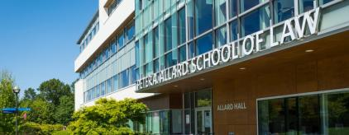
Office “Hours”: Jon
Room 449
Email jon.festinger@ubc.ca jfestinger@telus.net
Text (if urgent):
c. 604-837-6426

Slide 45
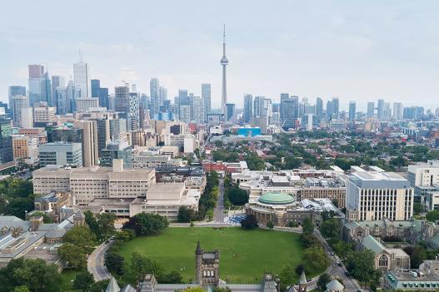
Office “Hours”: Rowan???
Email rowanasm@mail.ubc.ca
rowanasm@gmail.com

Slide 46
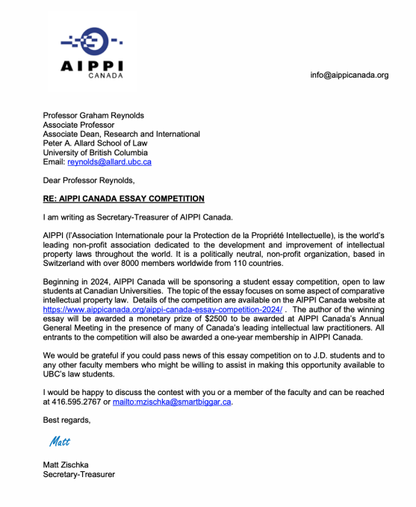

Slide 47
QUESTIONS
THOUGHTS
DISCUSSION

Slide 49
To Do’s
Psychological principles around conspiracy theories re: Taylor Swift and NFL wanting Chiefs to win the Super Bowl
Work through an AI problem and go through the AI creation steps, outline the legal issues, and create a chart (so we can work through our flowcharts with an AI problem in mind)
Look at how AI actually works to understand things like de minimis copying, fair dealing, and fixation requirements in the AI/Internet age
Work through an analysis of a YouTube Video
Also look at the telecommunications law provisions for fixation under the Copyright Act and when something is protected even if it normally wouldn't meet a fixation requirement
Talking more about regulatory stuff later in the course (e.g. FTC, etc.)

Slide 50
QUESTIONS
THOUGHTS
DISCUSSION

Slide 51
Real world context: Law of…

Slide 52
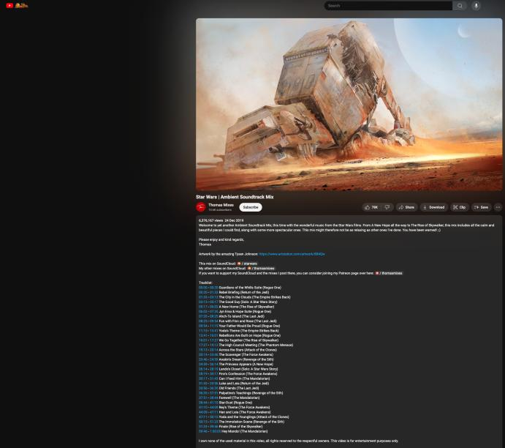
https://www.youtube.com/watch?v=lET5OZmJesA

Slide 53
“I own none of the used
material in this video, all rights reserved to the respectful owners. This video is for entertainment purposes only.”
Fair Dealing/Use??

Slide 54
https://www.youtube.com/watch?v=KDqjJRa2GpI

Slide 56
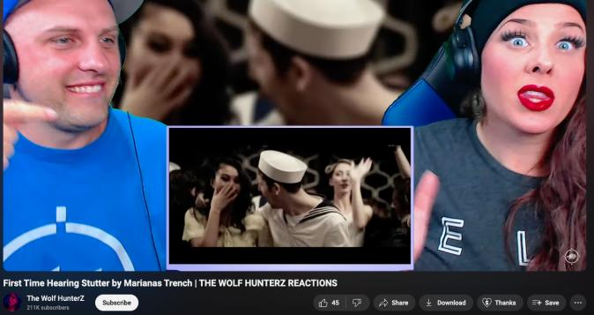
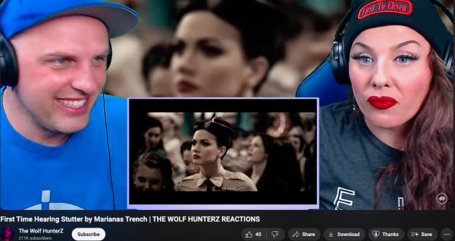

Slide 57
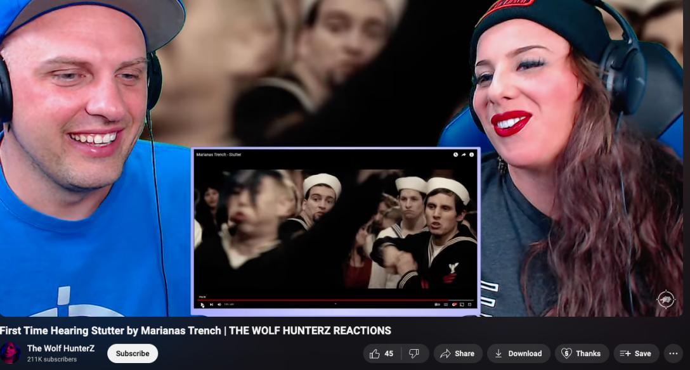
(…pause & discuss) x 2

Slide 58
“They should enter dancing with the Stars.”…
“Uh…Dang!...You hear them sing that”…
“They are going to ???? the military…
fighting each other. I didn’t realize that.”

Slide 60
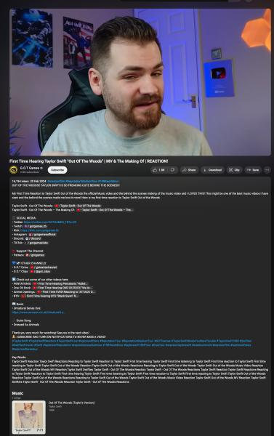
https://www.youtube.com/watch?v=5BswN_L9XgE

Slide 61
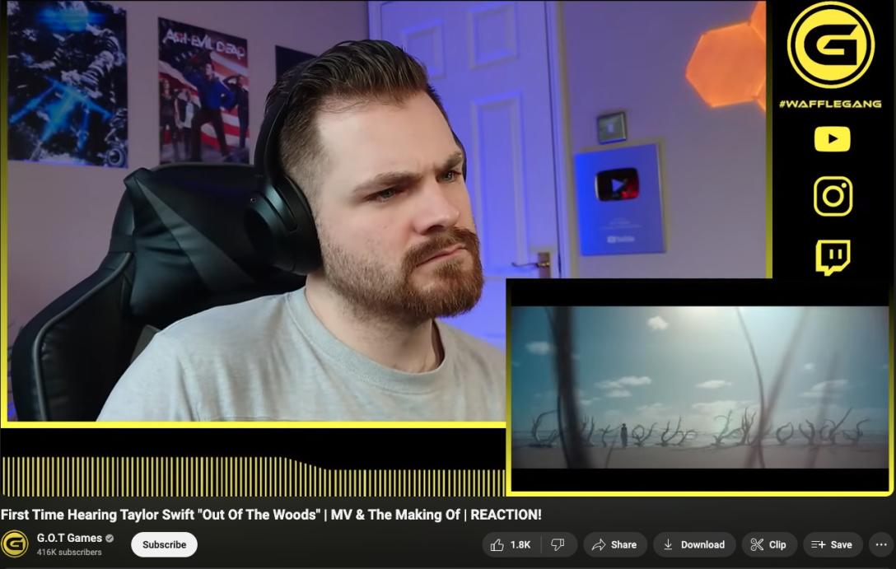

Slide 62
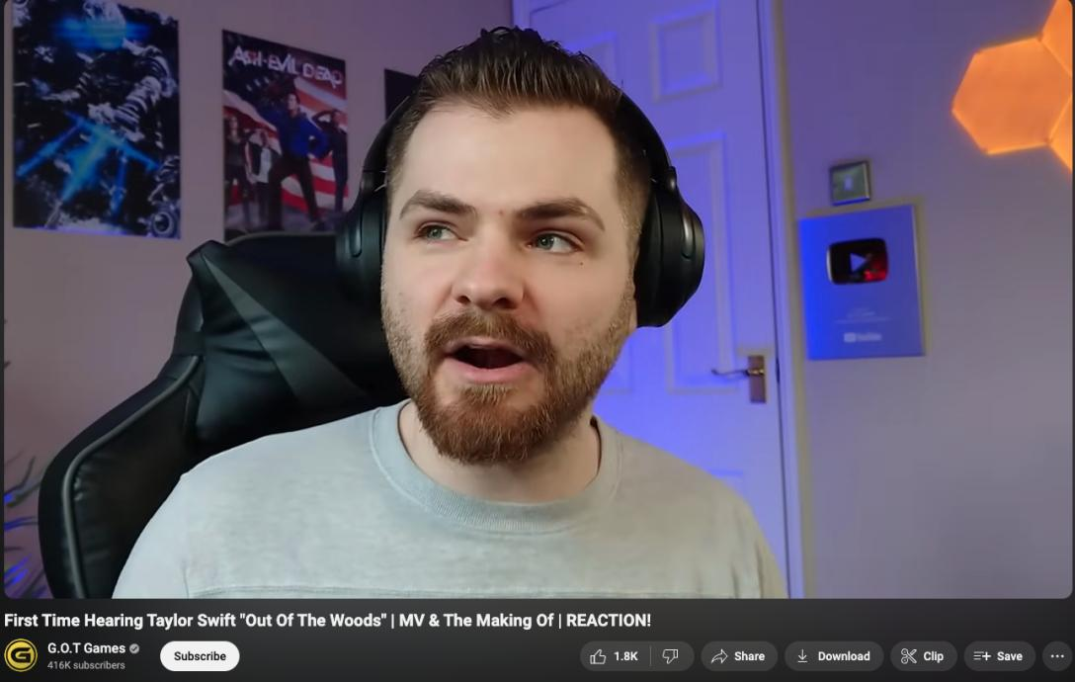

Slide 63
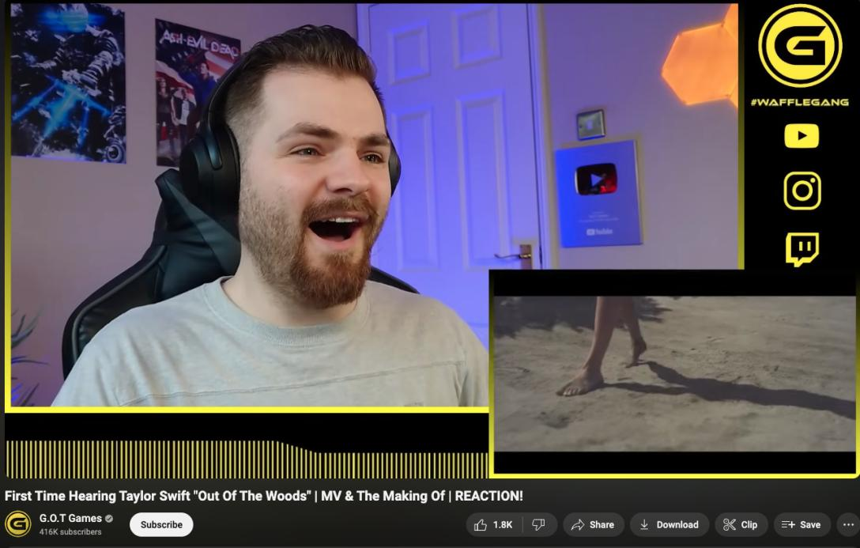

Slide 64
22:03
+
“Making of” video

Slide 65
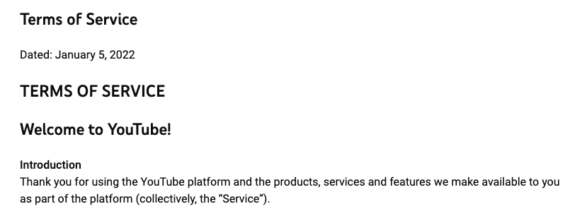

Slide 66
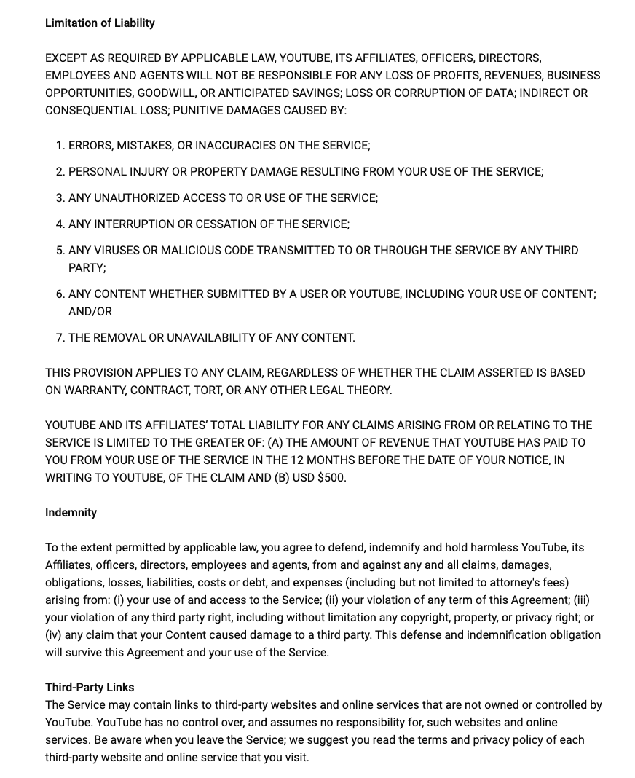

Slide 67
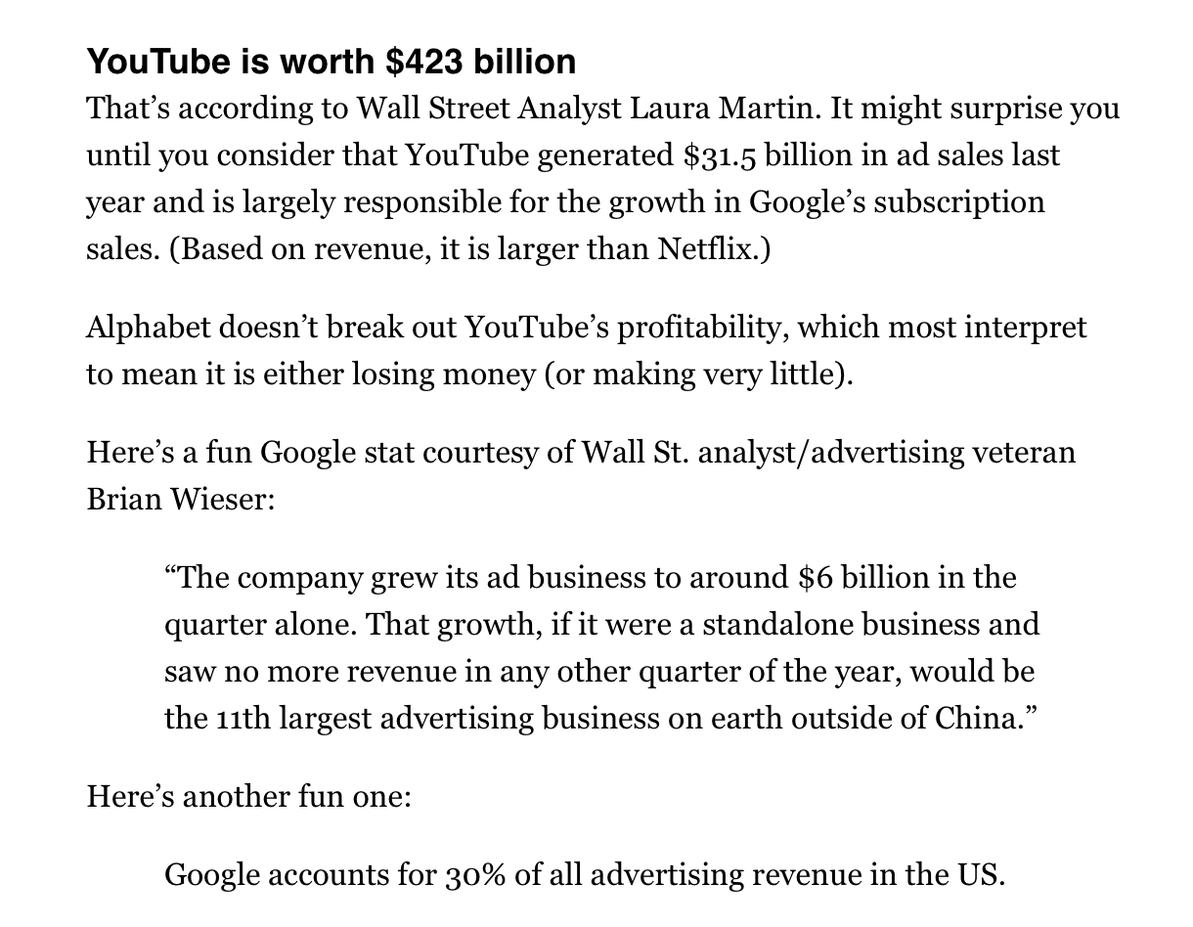

Slide 68
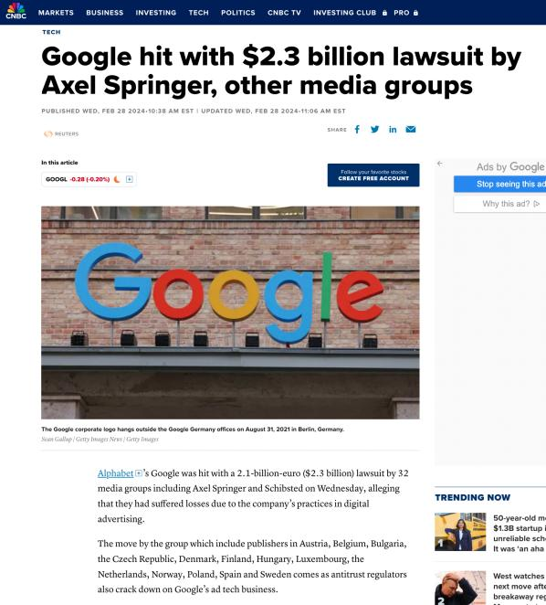

Slide 69
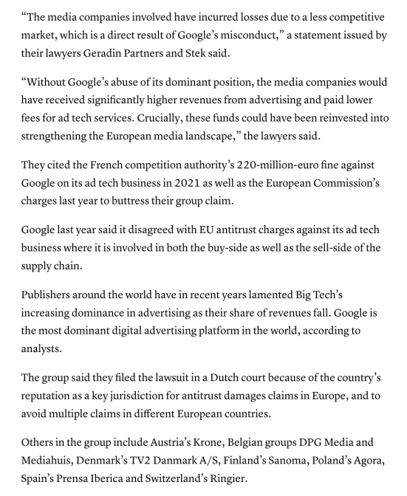

Slide 70
QUESTIONS?
THOUGHTS?
DISCUSSION?

Slide 71
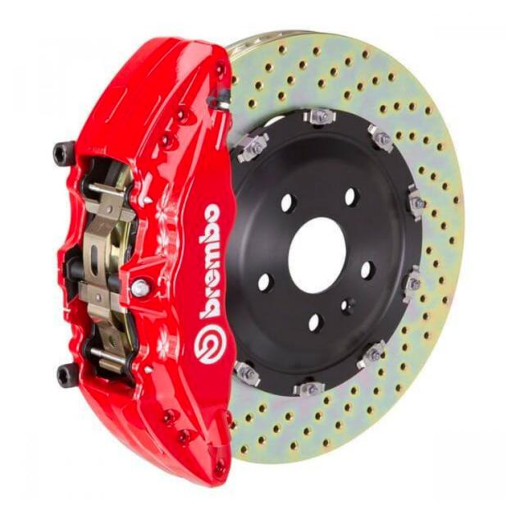

Slide 72
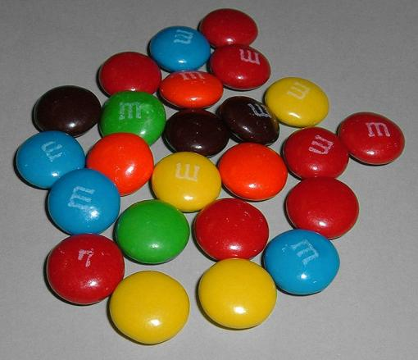
A MATTER OF PERSPECTIVE

Slide 73
Perspective
Earth from 900 Million Miles Away (2013 Cassini)

Slide 74
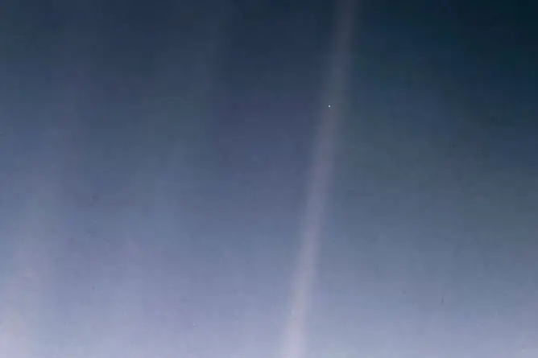
More Perspective
Earth from 3.7 Billion Miles Away (1990 Voyager 1)

Slide 76
Always include a cat picture

Slide 77
In learning you will teach
And in teaching you will learn
Phil Collins' Son of Man (1999)

